Slide 1


DevNet Workshop
Web and REST APIs
G. Capasso
16/04/2025

Slide 2
Table of contents
01
02
03
04
Introduction
HTTP protocol
JSON Format
REST APIs

Slide 3
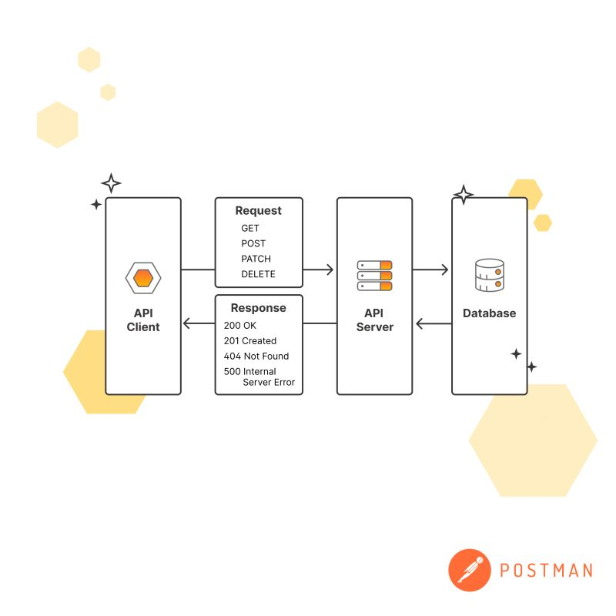
01
Introduction
What is an API?
Why would one need API?

Slide 4
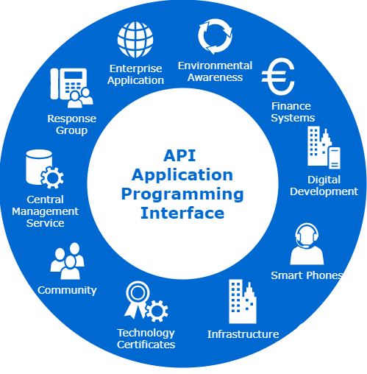







01
Application Programming Interface
Software-to-software interactions
Focus on components rather than applications
Easily integrate services in our applications
Software-to-Software = automation
Kinds of APIs:
Streaming API
Hardware/Video Acceleration API
Web Services API
Library based API

Slide 5
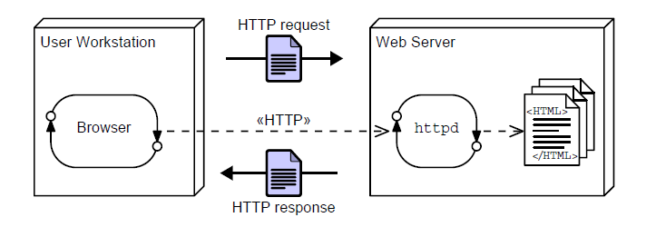
01
Our focus: Web APIs
One of the most used type of API
Leverages the well-known HTTP protocol
Requires a client-server architecture
Transfer data between client and server

Slide 6
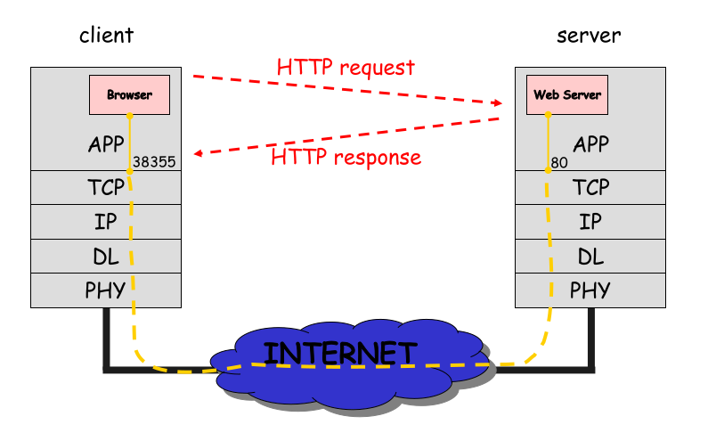
02
HyperText Transfer Protocol: HTTP
Url syntax http://<host>[:port]/path[#fragment]?query
Main client: our web browsers
A stateless protocol
Lots of versions:
Pre HTTP 1.0: 0.x
HTTP 1.0
HTTP 1.1
HTTP 2
HTTP 3
A text-based protocol till HTTP 2
Credits: Prof. S.P. Romano

Slide 7
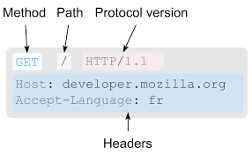
02
HTTP Requests
Every HTTP message has the same structure
Headers: key-value that adds extra information to the request
Body: the actual information requests
Methods: what we want to do with the request
GET
PUT
POST
DELETE
…others no one uses
Let’s see some requests from wireshark
https://developer.mozilla.org/en-US/docs/Web/HTTP/Guides/Overview

Slide 8
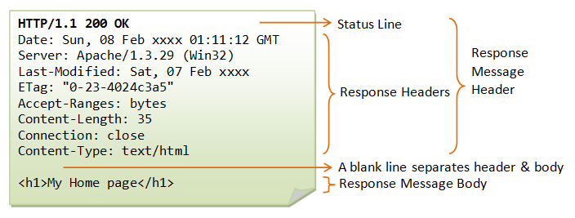
02
HTTP Responses
Must contain a status code:
1xx codes: Info status
2xx codes: OK
3xx codes: Redirection
4xx codes: Client error
5xx codes: Server error
Headers: add information to the response
Body: contains the requested data

Slide 9
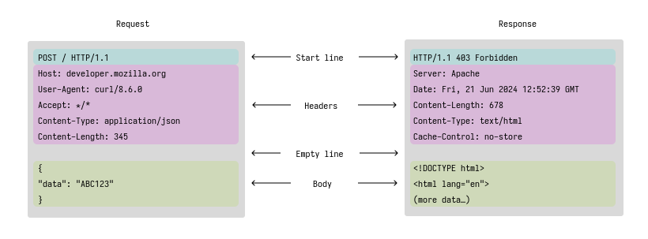
02
HTTP Communication
https://developer.mozilla.org/en-US/docs/Web/HTTP/Guides/Overview

Slide 10
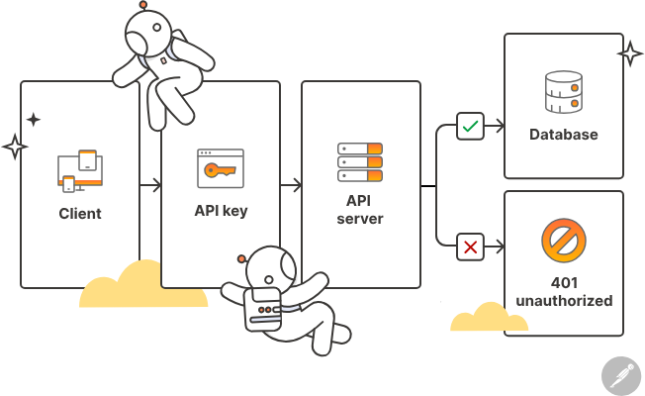
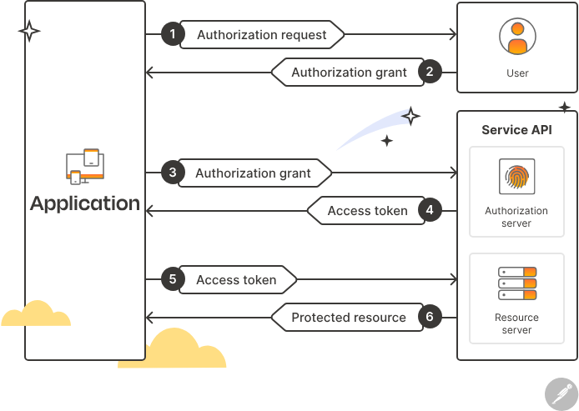
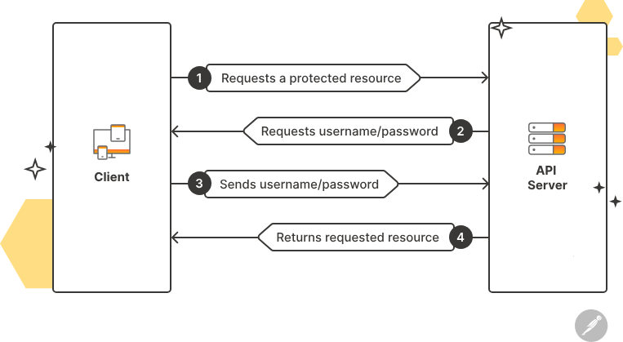
02
HTTP Security
How do we perform authentication and authorization?
All authentication methods will end up generating a token which will be included in a request header
Basic authentication
Bearer authentication
OAuth2
Authorization is typically role based

Slide 11
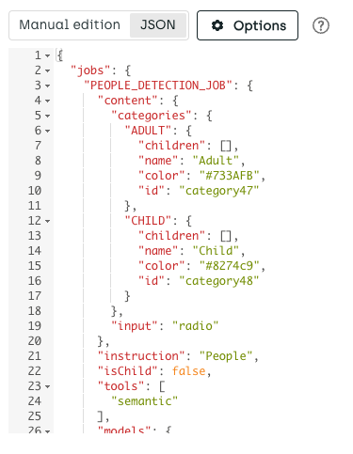
03
JSON: Javascript Object Notation
A text format like xml used in WEB api to exchange data
Similar to Python dictionaries
import json
Supports basic data types:
Objects
Numbers
Strings
Arrays
Example
https://www.reddit.com/r/cats/comments/1jyu8ko/this_devil_got_on_the_kitchen_slab_broke_two.json

Slide 12

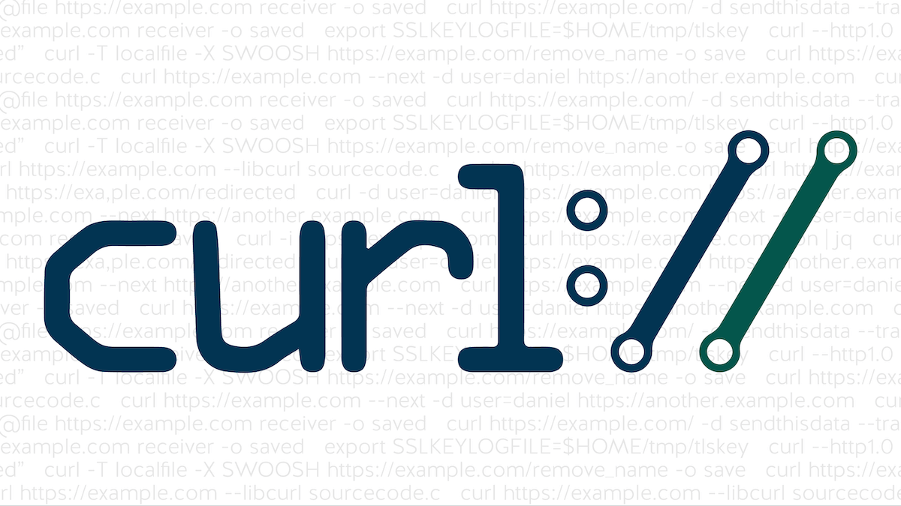

04
Let’s put it together: REST APIs
REST APIs:
API running on HTTP over JSON
REST:
Representational
State
Transfer
Tools we use:
Postman
Python: import requests
cURL

Slide 13

04
REST APIs: lab

Slide 14
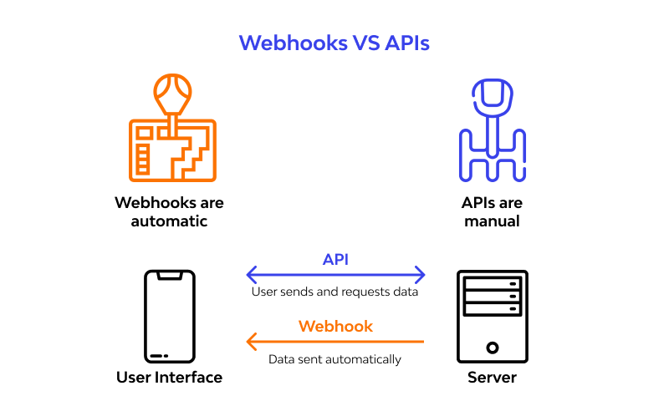
04
REST API: Webhooks

Slide 15
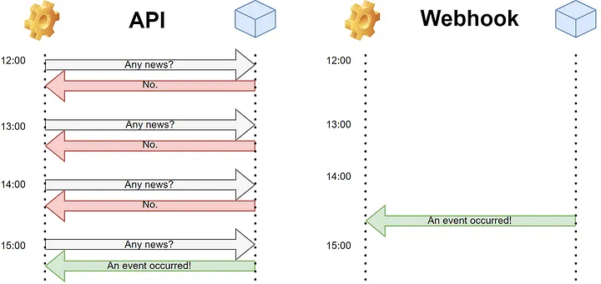
04
REST API: Webhooks

Slide 16
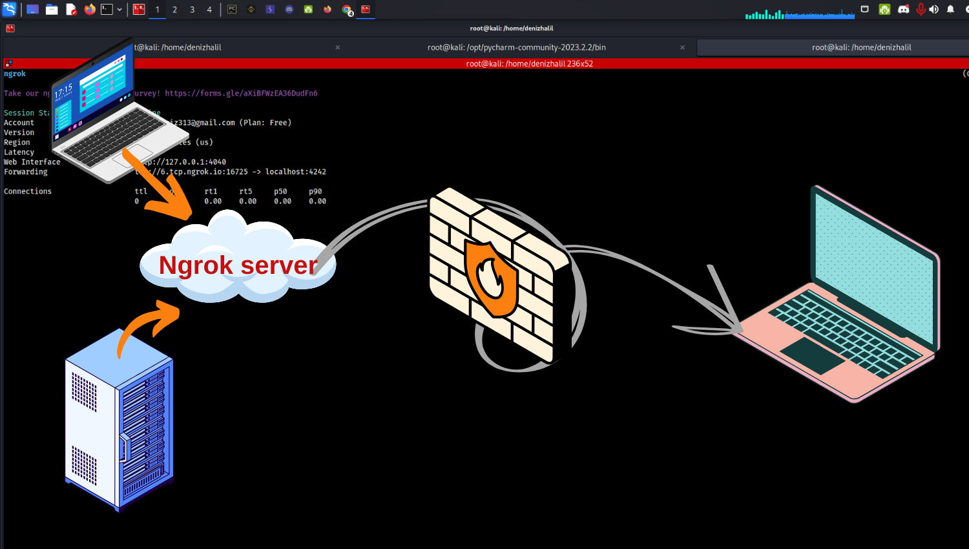
04
Webex Bot: network issues

Slide 17
04
REST APIs: pt2

Slide 18
Thanks!
Any questions?

